Slide 1

Mount Auburn Medical Associates
December 2, 2016
Community Learning Session

Slide 2
What did we work on?
Colon Cancer Screening
Appointment Referral Management
  100% of those who agree to be screened will either be secured an appointment with the Gastrointestinal Specialist for consideration of a colonoscopy or be provided testing materials for the FIT test.
“Closing The Loop”
  Reliable tracking system for Colo-rectal Screenings and or FIT Testing outcomes.
  Follow up conversations with those who have previously declined.

Slide 3
What did we measure?
How could we tell if a change worked?
We measured
Number of patients age 50 thru 80 who have not had a colon cancer screening with recommended studies within requisite time frame.
We know it worked because
All patients are having the conversation with the Medical Assistant and or Provider. The conversation is documented and a follow up conversation occurs at the next appointment
The appointment with the GI Specialist is scheduled and tracked
The FIT Screening has a due date and is tracked for completion

Slide 4
Example of changes that were tested?
Standardized:
Pre-Visit Planning expectation
Communication expectation and by whom
Documentation and tracking of scheduled GI appointments
Reliable process receiving and documenting GI notes
Outreach/documentation process when patients refuse
Communication process to schedule future appointments
Packaging, mailing and tracking of the FIT Tests
Outreach process and documentation for those without a visit
All members of the team are aware of the process

Slide 5
Patient Engagement
Patient Engagement in Improvement Process: Patients provided feedback on outreach letters and brochures used.
Patient Engagement in their Own Care: Letting the patient be a part of scheduling the appointment by identifying their preference of date, time, location and provider.

Slide 6
Process Changes
Pre-Visit Planning with the Medical Assistant and Provider.
The Medical Assistant has the initial conversations with the patient.
If they agree to the colonoscopy screening the MA automatically schedules the patient with their preference and tracks the referral.
If they agree to the FIT The MA reviews the test and expectations of when to return it with the patient. This too is tracked
If both screenings are refused, the provider will have the conversation during the visit.
Standard work flow once the patient agrees to either screening

Slide 7
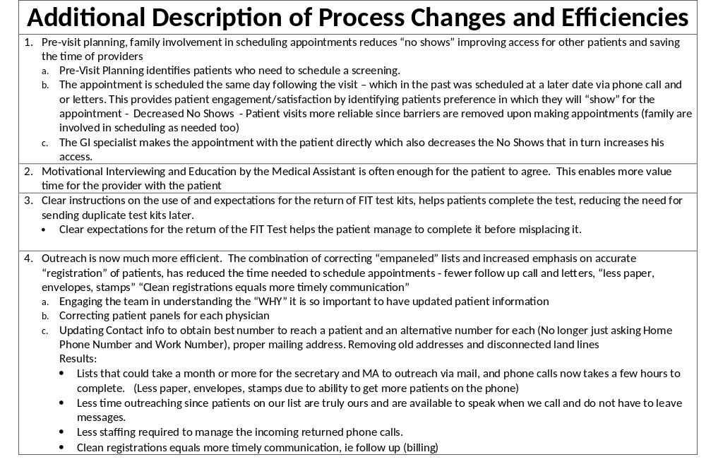

Slide 8
What were our results?

Slide 9
What did we learn?
Team Effort is a Sure Win!
Collaboration with the Specialists Team Improved our Patient and Staff Experience
  Completion of scheduled appointments. (Fewer No Shows Increased Access)
  Reliable Communication and Expectations
  (Documentation is standard. Everyone knows where our
  patients are in their decisions it is easier to manage them)

Slide 10
What’s Next?
Team Building with all the Specialists
Spreading the Standards Across MAPS Practices for All Measures including Mammogram and Cervical Cancer Screening
We will keep solving problems as a team!

Slide 11
What we will keep doing
Continue to use this Model of Improvement to optimize health system performance to
Improve the patient experience of care (including Quality, Safety and Satisfaction)
Improve the health of populations
Reduce the per capita cost of health care
Increase the joy for staff

